Slide 1
www.MINEPORTAL.in
ONLINE TEST SERIES FOR
DGMS COAL/METAL FIRST/SECOND CLASS EXAM
GATE MINING EXAM
OVERMAN EXAM TEST
MINING INSPECTOR EXAMS
COAL INDIA MTs & OTHER PSUs EXAMS
FREE STUDY MATERIAL & VIDEO LECTURES
MINING JOBS NOTIFICATIONS
www.mineportal.in Call/Whatsapp-8804777500 www.fb.com/mineportal.in

Slide 2
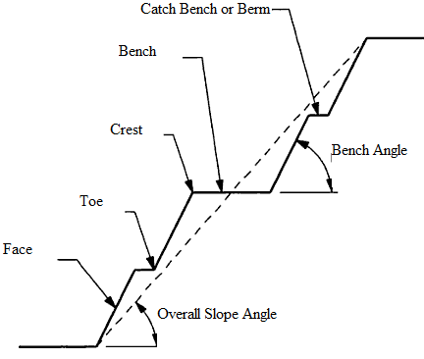
Slope Stability Analysis
Slope and Slope failures

Slide 3
Slope stability problem is greatest problem faced by the open pit mining industry. The scale of slope stability problem is divided in to two types:
1. Gross stability problem: It refer to large volumes of materials which come down the slopes due to large rotational type of shear failure and it involves deeply weathered rock and soil.
2. Local stability problem: This problem which refers to much smaller volume of material and these type of failure effect one or two benches at a time due to shear plane jointing, slope erosion due to surface drainage.
To study the different types and scales of failure it is essential to know the different types of the failure, the factors affecting them in details and the slope stability techniques that can be used for analysis.
Factors Affecting Slope Stability
1. Slope Geometry
The basic geometrical slope design parameters are height, overall slope angle and area of failure surface.
2. Geological Structure
The main geological structure are amount and direction of dip, shear zones, joints and discontinuities, faults.

Slide 4
3. Lithology
4. Ground water
5. Mining Method
(a) strike cut- advancing down the dip
(b) strike cut- advancing up the dip
(c) dip cut- along the strike
(d) open pit working
6. Dynamic Forces
Due to effect of blasting and vibration, shear stresses are momentarily increased and as result dynamic acceleration of material and thus increases the stability problem in the slope face. It causes the ground motion and fracturing of rocks.
7. Cohesion
It is the characteristic property of a rock or soil that measures how well it resists being deformed or broken by forces such as gravity.
8. Angle of Internal Friction
Angle of internal friction is the angle (φ ), measured between the normal force (N) and resultant force (R), that is attained when failure just occurs in response to a shearing stress (S). Its tangent (S/N) is the coefficient of sliding friction. It is a measure of the ability of a unit of rock or soil to withstand a shear stress.

Slide 5
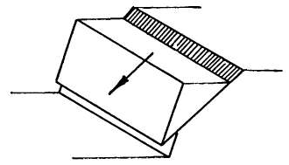
Types of Slope Failure
1. Plane Failure
Simple plane failure is the easiest form of rock slope failure to analyze. It occurs when a discontinuity striking approximately parallel to the slope face and dipping at a lower angle intersects the slope face, enabling the material above the discontinuity to slide.
Variations on this simple failure mode can occur when the sliding plane is a combination of joint sets which form a straight path.

Slide 6
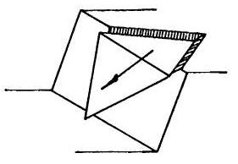
2. Wedge Failure The three dimensional wedge failures occur when two discontinuities intersects in such a way that the wedge of material, formed above the discontinuities, can slide out in a direction parallel to the line of intersection of the two discontinuities. It is particularly common in the individual bench scale but can also provide the failure mechanism for a large slope where structures are very continuous and extensive.

Slide 7
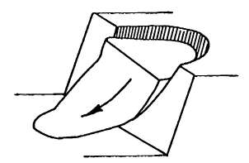
3. Circular Failure Surface of the failure in spoil dumps or soil slopes resembles the shape of a circular arc. This failure can occurs in soil slopes, the circular method occurs when the joint sets are not very well defined. When the material of the spoil dump slopes are weak such as soil, heavily jointed or broken rock mass, the failure is defined by a single discontinuity surface but will tend to follow a circular path.

Slide 8
Circular failure is classified in three types depending on the area that is affected by the failure surface. They are:-
(a) Slope failure: In this type of failure, the arc of the rupture surface meets the slope above the toe of the slope. This happens when the slope angle is very high and the soil close to the toe posses the high strength.
(b) Toe failure: In this type of failure, the arc of the rupture surface meets the slope at the toe.
(c) Base failure: In this type of failure, the arc of the failure passes below the toe and in to base of the slope. This happens when the slope angle is low and the soil below the base is softer and more plastic than the soil above the base.
4. Toppling Failure
Toppling or overturning has been recognized by several investigators as being a mechanism of rock slope failure and has been postulated as the cause of several failures ranging from small to large ones.
It occurs in slopes having near vertical joint sets very often the stability depends on the stability of one or two key blocks.

Slide 9
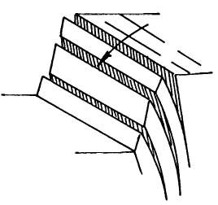

Slide 10
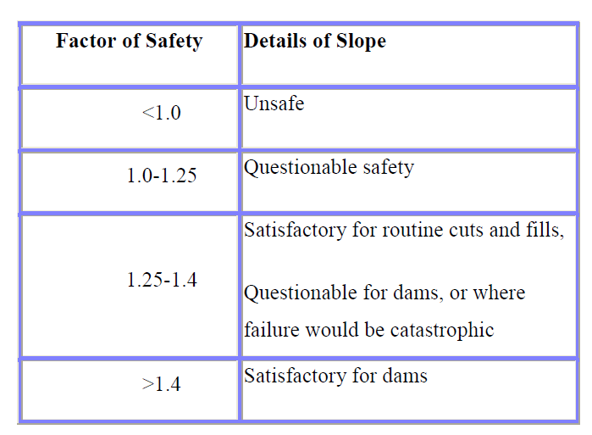

Slide 11
Methods of Analysis
1. Wedge Failure Analysis
(A) Spherical Projection Solution using Factor of Safety
The 3D wedge problem can be very easily analyzed using spherical projection techniques. When the shear strength of the shear surface is entirely frictional and there is no external force, the problem becomes dimensionless and can be analyzed very simply by the means of a stereo net analysis alone. The introduction of water pressure or the external forces requires the use of side calculations to determine the orientation of the resultant forces acting on the wedge.
(B) Chart Solution
Hoek and Bray (1980) produced a series of charts which can be used to rapidly access the stability of rock wedges for which there is know cohesion or external forces. Under these condition and for a given friction angle, the factor of safety is a function only of the dip and direction of the shear plane. These charts are convenient to use for use simple wedge problem but suffer from the disadvantage that it does not give the feel of the problem.

Slide 12
(C) Spherical Projections Solutions using Probabilistic Approach
Monte Carlo analysis of the wedge failure gives, with a specified confidence level, the
uncertainty in the orientations of the shear planes. When the orientations of the shear planes are known then the spherical projection technique can be used to find out the orientation of the failure plane.
2. Circular Failure Analysis
The stability of the slopes of finite extent like that in the case of circular is analyzed by the method of dividing the whole suspected failure area in to slices and further analyzing the sequence of events that may follow thereafter. There are several methods of slices in their new advancement together with friction circle method and tailors stability number method.
(A) Method of Slices
This method was advanced by the Swedish geotechnical commission and developed by W.Fellienius (1936). By dividing the mass above an assumed rupture surface of failure in to vertical slices and assuming that the forces on the opposite sides of each slice are equal and opposite, a statistically determinate problem is obtained and semi graphical method have been devised by which the stability of the mass may be analyzed for any given circle.
The main objection of this method is that the most dangerous of infinite number of circles are to be found out for which graphical method is to be used for a number of time.

Slide 13
(B) Modified Method of Slices
When there are several dangerous circles to be analyzed usual procedure by the slice method is quite tedious. N.C.Coutrney of U.S.A. has developed simple graphical solutions by which the forces that are inherent in the method of slices such as the forces acting on the vertical sides of the slices.
(C) Simplified Method of Slices
This method takes in to account the forces acting on the vertical sides of the slices in the development of an equation for determining the factor of safety. However, the simplified equation proposed by Bishop (1955) does not contain the forces acting on the vertical sides and there by simplifies the computation.
(D) Friction Circle Method
It is a very convenient method which takes in to account the total forces acting on the whole mass lying above the assumed circular surface of failure. This method eliminates the indeterminate forces that are inherent in the method of slices such as acting on the vertical sides of the slices.
(E) Taylor’s Stability Number
Taylor (1937) made a mathematical trial method using the friction circle method. Charts as formulated by Taylor give the relationship between stability number and the slope angle for various angle of friction. This method is applicable to homogeneous simple slopes without seepage.

